Slide 1
SELENIUM TRAINING
GM QA Capability Team

Slide 2
AGENDA
Test Automation for Web Application.
History and Overview Of Selenium

Slide 3
Test Automation for Web Application
Many, perhaps most, software applications today are written as web-based applications to be run in an Internet browser. The effectiveness of testing these applications varies widely among companies and organizations. In an era of highly interactive and responsive software processes where many organizations are using some form of Agile methodology, test automation is frequently becoming a requirement for software projects. Test automation is often the answer. Test automation means using a software tool to run repeatable tests against the application to be tested. For regression testing this provides that responsiveness.
There are many advantages to test automation:
Frequent regression testing
Rapid feedback to developers
Virtually unlimited iterations of test case execution
Support for Agile and extreme development methodologies
Disciplined documentation of test cases
Customized defect reporting
Finding defects missed by manual testing

Slide 4
Brief History of Selenium
Selenium first came to life in 2004 when Jason Huggins was testing an internal application at ThoughtWorks. He developed a Javascript library that could drive interactions with the page, allowing him to automatically rerun tests against multiple browsers. That library eventually became Selenium Core, which underlies all the functionality of Selenium Remote Control (RC) and Selenium IDE. Selenium RC was ground-breaking because no other product allowed you to control a browser from a language of your choice.
While Selenium was a tremendous tool, it wasn’t without its drawbacks. Because of its Javascript based automation engine and the security limitations browsers apply to Javascript, different things became impossible to do. To make things worse, webapps became more and more powerful over time, using all sorts of special features new browsers provide and making this restrictions more and more painful.
In 2006 a engineer at Google named Simon Stewart started work on a project he called WebDriver. Google had long been a heavy user of Selenium, but testers had to work around the limitations of the product. Simon wanted a testing tool that spoke directly to the browser using the ‘native’ method for the browser and operating system, thus avoiding the restrictions of a sandboxed Javascript environment. The WebDriver project began with the aim to solve the Selenium’ pain-points.

Slide 5
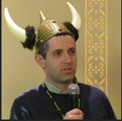


HISTORY OF SELENIUM
Jason Huggins developed Java Script library in 2004
Simon Stewart created Web driver in 2006
Finally we saw the merging of Selenium and Webdriver in 2008

Slide 6
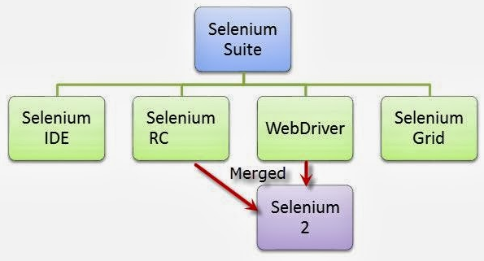
WHAT IS SELENIUM?
Selenium is a suite of tools to automate web browsers across many platforms. It supports the most of the browsers being used.
The below image show the various components of Selenium

Slide 7

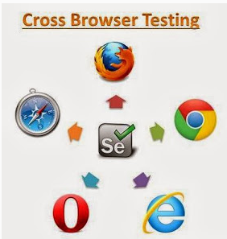
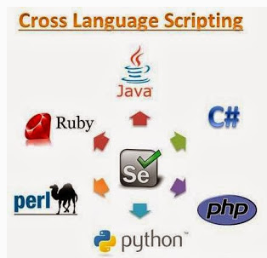

FEATURES OF SELENIUM

Slide 8
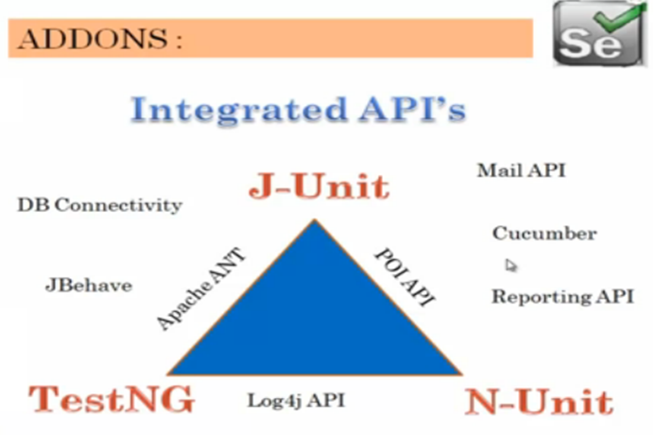
EXTERNAL API’S
To support additional features like parameterization, reporting, database connectivity etc., and to create an end to end solution the user will require lot of additional API’s as depicted in below image.

Slide 9
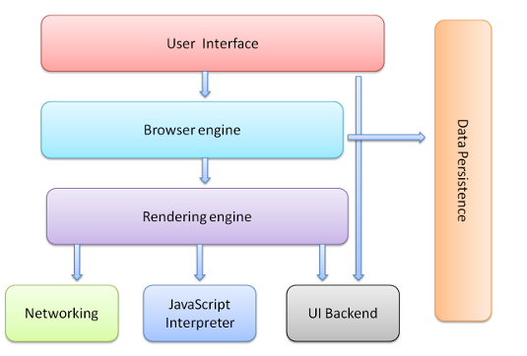
TESTING ON MULTIPLE BROWSERS (COMPATIBILITY TESTING)
Every browser consists of different layers which comprises the architecture of the browser. It’s necessary to ensure that web application works on all the major browsers.
Key components of browsers are shown as below:

Slide 10
RENDERING BROWSERS
Below is the snapshot listing the engines used across browsers:
Blink
Trident
Gecko
Blink
Webkit
Notes:
Fonts are not available
Support for new html

Slide 11
INTRODUCTION TO WEB TECHNOLOGIES

Slide 12
WEB TECHNOLOGIES
The most commonly used techniques that are used for web development and for writing Selenium scripts are:
HTML
JAVASCRIPT
DOM
CSS

Slide 13
WHAT IS HTML?
HTML is a language for describing web pages
HTML stands for Hyper Text Markup Language
HTML is a markup language
A markup language is a set of markup tags
The tags describe document content
HTML documents contain HTML tags and plain text
HTML documents are also called web pages

Slide 14
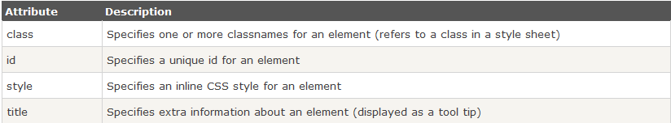
HTML ATTRIBUTES
HTML elements can have attributes
Attributes provide additional information about an element
Attributes are always specified in the start tag
Attributes come in name/value pairs like: name="value“

Slide 15
Exercise
Create a list of HTML tags for different element types

Slide 16
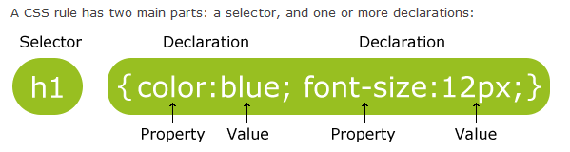
WHAT IS CSS?
CSS stands for Cascading Style Sheets
Styles define how to display HTML elements
Used for describing the look and formatting of a document
It can be applied to any xml document
Notes:
External style sheet
<head> <link rel="stylesheet" type="text/css" href="mystyle.css"> </head>
Internal style sheet
hr {color:sienna;} p {margin-left:20px;} body {background-image:url("images/background.gif");}
Inline style

Slide 17

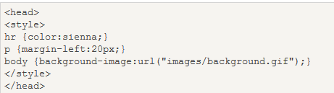
CSS ATTRIBUTES
CSS are used to change UI attributes of a web element
Example:
Background Color
Font Color
Font Size
Alignment
Font Style
And many more…
Implementation of CSS
External Style Sheet
Internal Style Sheet
Inline Styles

Slide 18
WHAT IS JAVASCRIPT?
Javascript is a dynamic computer programming language. It is most commonly used as a part of web browsers, whose implementation allow client-side scripts to interact with the user, control the browser, control asynchronously, and alter the document content that is displayed.
USAGE
Loading new page content or submitting data to a server via AJAX
Animation of page elements
Interactive Content
Validating Input fields
Transmitting information about the user's reading habits and browsing activities to various websites
Notes:
Events like onClick , onBlur . Onload
http://www.w3schools.com/js/js_events_examples.asp

Slide 19
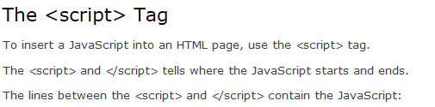
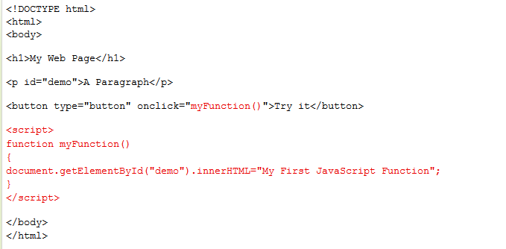
JAVASCRIPT
EXAMPLE:

Slide 20
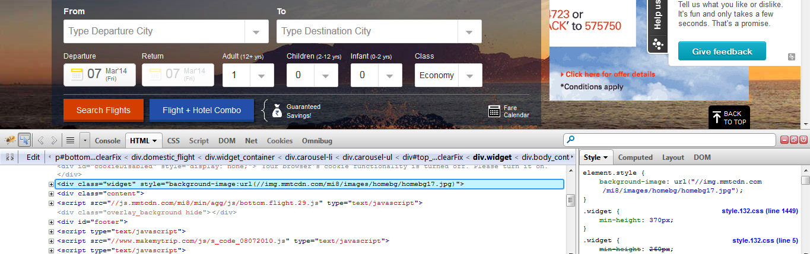
OBJECT SPY
Every browser has in built capability to check the properties of any element. It can be done by installing few add ins through which the properties of each element can be analyzed.
Firebug and FirePath for Firefox
https://getfirebug.com/downloads/
IE Developer for Internet Explorer
http://www.microsoft.com/en-in/download/details.aspx?id=18359
Chrome Dev Tools
https://developers.google.com/chrome-developer-tools/

Slide 21
Quiz
What does HTML stand for?
Which HTML tag/element creates a link to another page or a section of a same document?
Which HTML tag/element accepts user inputs?
Mention any 2 usage of Javascript.
What is the use of <script> tag in HTML?

Slide 22
SELENIUM IDE

Slide 23
SELENIUM IDE
Prototyping Tool for building test cases
Firefox Plugin
Easy to use interface
Provides record and playback mechanism
Can be exported to different languages
HTML Suites can be created
Note : It is not recommended to use record and playback for any automation solution

Slide 24
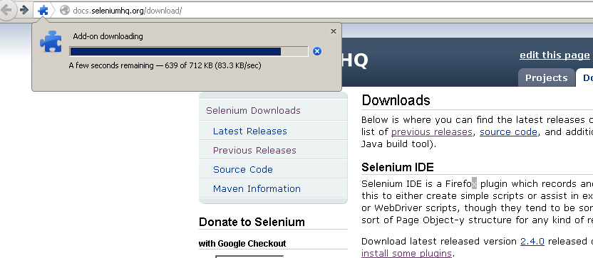
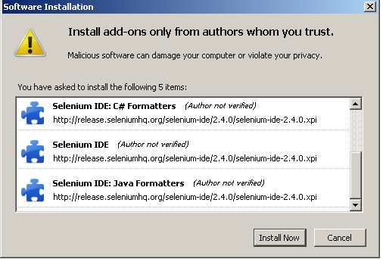
INSTALLATION
Navigate to url: http://docs.seleniumhq.org/download/
Under the section “Selenium IDE” Download the latest version
Click Install Now on the Software Installation window
Proceed with installation and restart browser
Sometimes, the latest version of IDE may not work, in that case try to degrade the browser version.

Slide 25
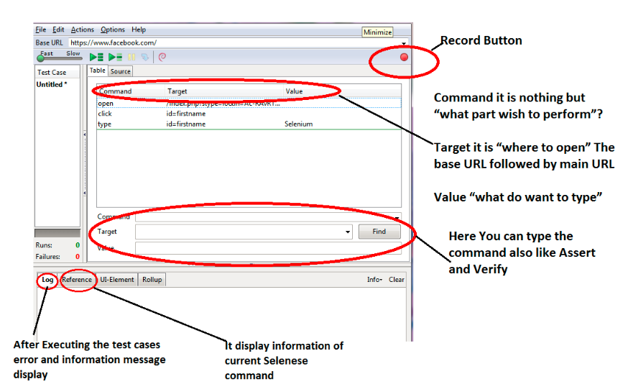
SELENIUM IDE USER INTERFACE

Slide 26
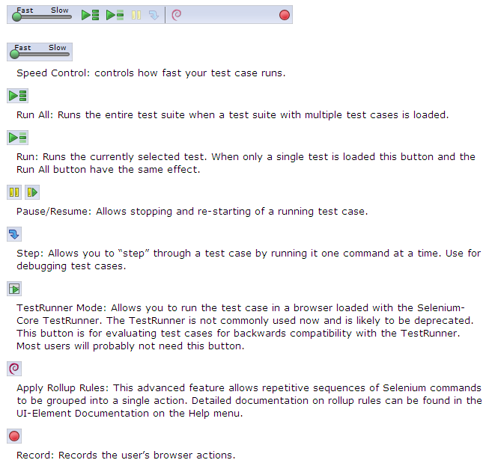
MENU

Slide 27
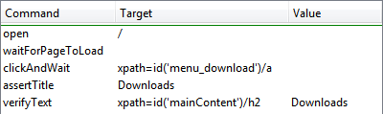

IDE TEST PANE
It has two tabs, one for displaying the command and their parameters in a readable “table” format.
The second tab - Source displays the test case in the native format in which the file will be stored by default it is HTML.
The Source view also allows to edit the test case in its raw form, including copy, cut and paste operations.
The Command, Target, and Value entry fields display the currently selected command along with its parameters.

Slide 28

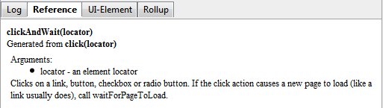
LOGS AND REFERENCE
Log:
Display test cases in progress, error messages and information messages.
These messages are often useful for test case debugging.
Info button is a drop-down allowing selection of different levels of information to log.
Reference:
Reference tab is the default selection whenever you are entering or modifying commands and parameters in Table mode
Reference pane display documentation on the current command.
When entering or modifying commands, whether from Table or Source mode, it is important to ensure that the parameters specified in the Target and Value fields match those specified in the parameter list in the Reference pane

Slide 29
BUILDING TEST CASES
There are three primary methods for developing test cases:
Recording:
First-time users begin by recording a test case from their interactions with a website. When Selenium-IDE is first opened, the record button is ON by default.
Adding Verifications/Asserts:
Test cases will also need to check the properties of a web-page. This requires assert and verify commands.
Editing:
Insert Command:
Table View
Source View
Save:
Selenium distinguishes between test cases and test suites. To save Selenium-IDE tests for later use you can either save the individual test cases, or save the test suite

Slide 30
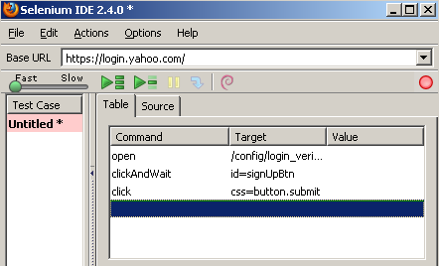
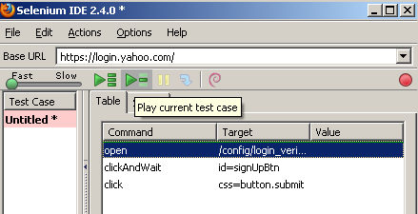
RECORDING AND RUNNING SCRIPTS WITH IDE
Open Firefox browser
Click Tools > Selenium IDE
Click on the red Record button on right side, if not
clicked already
By default, the record button is clicked
Browse to the application site in the browser
Perform the required steps manually in the browser
Observe the steps being recorded in the IDE
The button highlighted on right image can be used to run the test case
The left portion of the IDE window displays
The test result
No. of Runs: Tells the no. of test cases run
Failures: Tells the no. of test cases failed

Slide 31
RUNNING TEST CASES
Running Test Case:
Run a Test Case
Run a Test Suite
Stop and Start
Stop in the Middle
Start from the Middle
Run Any Single Command
Using Base URL:
Allows test cases to be run across different domains.
Selenium Commands – “Selenese”:
A command is what tells Selenium what to do. Selenium commands come in three “flavors”:
Actions
Accessors
Assertions

Slide 32
SOME USEFUL SELENIUM COMMANDS
The most commonly used commands for building tests are:
Open: opens a page using a URL.
Click/clickAndWait: Performs a click operation, and optionally waits for a new page to load.
VerifyTitle/assertTitle: verifies an expected page title.
VerifyTextPresent : verifies expected text is somewhere on the page.
VerifyElementPresent : verifies an expected UI element, as defined by its HTML tag, is present on the page.
VerifyText : verifies expected text and its corresponding HTML tag are present on the page.
WaitForPageToLoad : Pauses execution until an expected new page loads. Called automatically when clickAndWait is used.
WaitForElementPresent : Pauses execution until an expected UI element, as defined by its HTML tag, is present on the page

Slide 33
LOCATING ELEMENTS
Locator Types:
Locating by Id
Locating by Name
Locating by XPath
Locating Hyperlinks by Link Text
Locating by DOM
Locating by CSS
Note : These strategies will be discussed in details during webdriver session

Slide 34
SYNCHRONIZATION
It is very important to wait for the element to reach a state where further action can be performed on it. Selenium IDE provides some of the inbuilt methods to achieve the synchronization.
Page Load and Refresh:
Wait for the page to load. E.g.
clickAndWait
checkAndWait
selectAndWait
Handling AJAX:
With the help of AJAX, any element can be changed without refreshing the whole page. So normal page wait doesn’t work under such conditions.
We can use following methods:
waitForElementPresent
waitForVisible

Slide 35


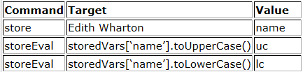
STORE COMMANDS AND SELENIUM VARIABLES
To save the values in a variable to be used somewhere else inbuilt commands allows the user to save the values as variables
Store the value in variable
Use the value in variable
storeElementPresent
storeText
storeEval

Slide 36
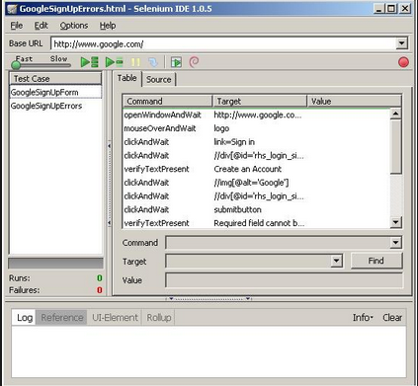
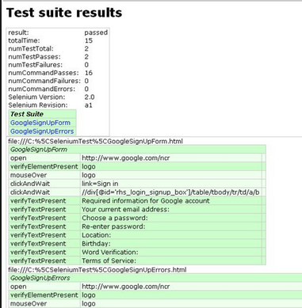
HTML SUITE
It is a set of individual test cases which can be run on any browser with the help of selenium server.
To execute the HTML Suite, below command will be used.

Slide 37
Quiz
In Selenium IDE, which command is used to print?
What is the difference between a command and the same command with "AndWait" (e.g. click and clickAndWait commands)?
Selenium IDE scripts can be exports to different laguages. True or False?

Slide 38

Assessment
On www.facebook.com signup page, identify different tags available for different field types
Create element locator for the following fields

Slide 39
AGENDA
Overview of Selenium RC
Selenium Webdriver Architecture
Object Identification Techniques
Different Drivers
Synchronization

Slide 40
OVERVIEW OF SELENIUM RC

Slide 41
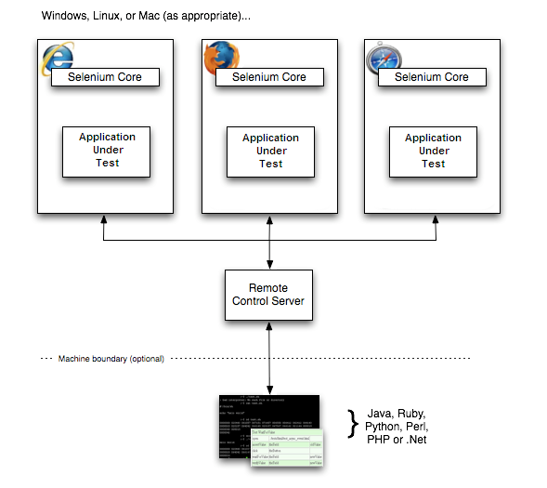
SELENIUM RC
Selenium RC components are:
The Selenium Server which launches and kills browsers, interprets and runs the Selenese commands passed from the test program, and acts as an HTTP proxy, intercepting and verifying HTTP messages passed between the browser and the AUT.
Client libraries which provide the interface between each programming language and the Selenium RC Server.

Slide 42
SELENIUM WEBDRIVER ARCHITECTURE

Slide 43
SELENIUM WEBDRIVER
WebDriver is a tool for writing automated tests of web based applications
It mimics the behavior of a real user
It access the native API of browsers to provide the support for automation.
Supports the integration with many external 3rd party API

Slide 44
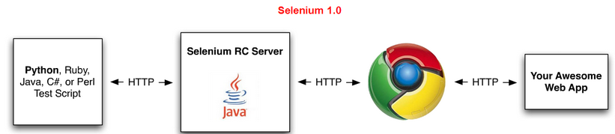
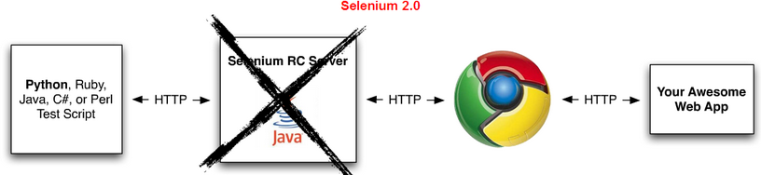
RC Vs. WEBDRIVER
Selenium-WebDriver makes direct calls to the browser using each browser’s native support for automation
Selenium RC ‘injected’ javascript functions into the browser when the browser was loaded and then used its javascript to drive the AUT within the browser

Slide 45
SELENIUM SERVER
Selenium server has to be launched explicitly only under the following conditions:
Using Selenium Grid to distribute the tests
Running the scripts on a remote machine.
Not using Java bindings and would like to use html unit driver named as HtmlUnitDriver
Note : The standalone jar contains everything including the remote selenium server and the client-side bindings

Slide 46
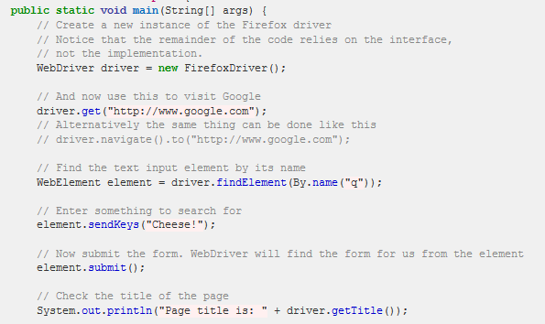
FIRST WEBDRIVER SCRIPT
For the setup, associate the latest selenium jar file to the project. JAR file can be downloaded from http://docs.seleniumhq.org/download/

Slide 47
Quiz
Mention any 2 differences between Selenium RC and Web driver

Slide 48
OBJECT IDENTIFICATION TECHNIQUES

Slide 49
OBJECT IDENTIFICATION TECHNIQUES
Every object visible on a webpage is a “WebElement”.
To interact with the element create a reference to that particular element.
By ID:
By ClassName:
By TagName:
By Name:

Slide 50
OBJECT IDENTIFICATION TECHNIQUES
By Xpath : This technique is one of very powerful way of identifying the objects. With the help of xpath, user can find siblings, parent, children, grandparent of a web element.
Text() function:
//a[text()=‘test’]
//a[contains(text(),’test’)]
Accessing parent
//a[@id=‘user’]/parent::li
Accessing grandparents
//a[@id=‘user’]//ancestor::ul//div[@id=‘test’]
Some other functions
//div[@id=‘userdetails’]/ul[1]
//div[@id=‘userdetails’]//ul[last()]
//div[@id=‘userdetails’]//ul[last()-1]
//div[starts-with(@class,'feature-event')]

Slide 51
OBJECT IDENTIFICATION TECHNIQUES
By CSS
Using CSS selector we can access particular node or immediate child of any node.
Can combine as many conditions as we want for single node.
Can achieve starts-with, contains functionality using ^,* symbols respectively.
We can’t traverse back using CSS selector.
Examples:
css = div.className
css = #id
css = div a

Slide 52
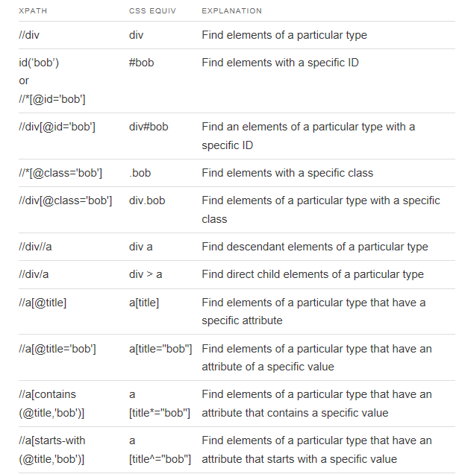
CSS EQUIVALENT OF XPATH

Slide 53
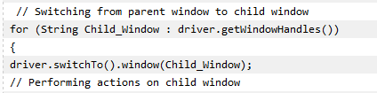
WORKING WITH MULTIPLE WINDOWS AND FRAMES
Multiple Windows
Dealing with multiple windows in Automation Testing has always been a little tricky and requires extra effort. To work with multiple windows it requires to switch the control to the new window which can be done with the help of window handlers.
Frames
An inline frame is used to embed another document within the current HTML document.
User need to switch to the iframe before doing any action on it
Switching to the frame: driver.switchTo().frame("frame1");
Switching back to the parent window: driver.switchTo().defaultContent();

Slide 54
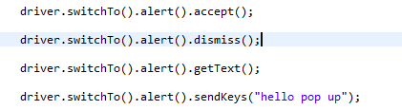
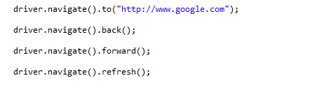
HANDLING ALERTS
JavaScript has three kind of popup boxes: Alert box, Confirm box, and Prompt box.
To handle the alerts webdriver has provided a “Alerts” class.
Navigation
With the help of navigation methods, user can do operations like back button click, forward button click and refresh the page
Notes:
Go To http://www.quackit.com/javascript/
Handle Alerts
Handle new window

Slide 55
Quiz
Why use an XPath locator?
What is the syntax to switch to a frame?
What is the syntax to switch back to parent window?
Webdriver has provided which class handle to Javascript alerts?

Slide 56
Overview of TestNG

Slide 57
TestNG
It is a testing framework inspired from JUnit and NUnit but introducing some new functionalities that make it more powerful and easier to use.
TestNG is an open source automated testing framework; where NG of TestNG means Next Generation. TestNG is similar to JUnit (especially JUnit 4), but its not a JUnit extension. Its inspired by JUnit. It is designed to be better than JUnit, especially when testing integrated classes. The creator of TestNG is Cedric Beust.

Slide 58
TestNG Features
Annotations.
TestNG uses more Java and OO features.
Supports testing integrated classes (e.g., by default, no need to create a new test class instance for every test method).
Separate compile-time test code from run-time configuration/data info.
Flexible runtime configuration.
Introduces ‘test groups’. Once you have compiled your tests, you can just ask TestNG to run all the "front-end" tests, or "fast", "slow", "database", etc…
Supports Dependent test methods, parallel testing, load testing, partial failure.
Flexible plug-in API.
Support for multi threaded testing.

Slide 59
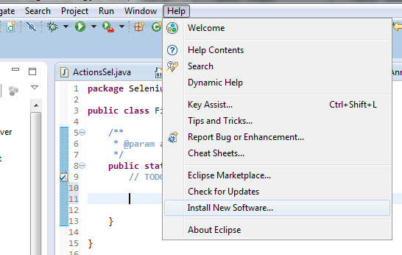
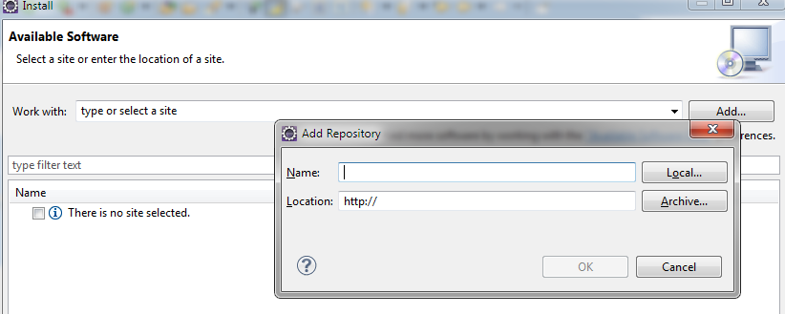
TestNG Setup in Eclipse
TestNG provides an add in which can be installed in eclipse to use TestNG framework
Open Help ->Install New Software
In the install window click onAdd

Slide 60
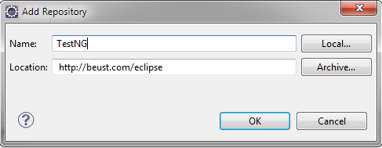
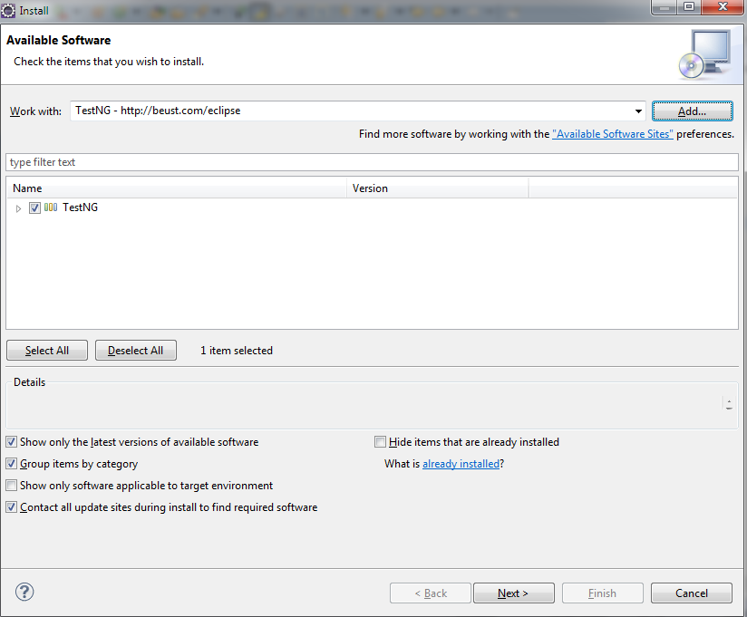
Contd…
Under the Add Repository window enter the values as shown below :
Select TestNG and click next. Follow the steps for the installation.

Slide 61
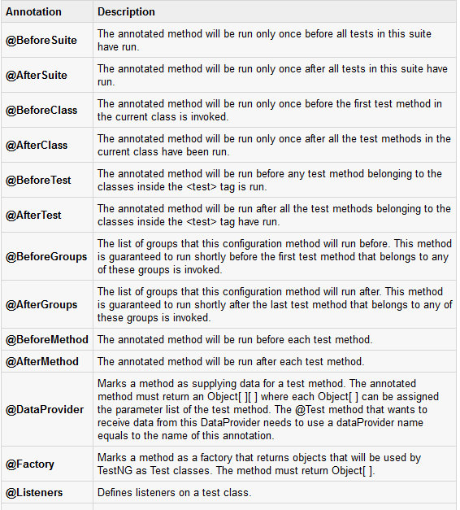
TestNG Annotations

Slide 62
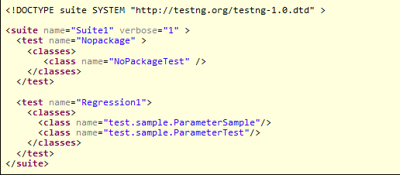
TestNG Suite
A Test suite is a collection of test cases that are intended to test a behavior or set of behaviors of software program. In TestNG, we cannot define a suite in testing source code, but it is represented by one XML file as suite is the feature of execution. This also allows flexible configuration of the tests to be run. A suite can contain one or more tests and is defined by the <suite> tag.
Define the suite

Slide 63

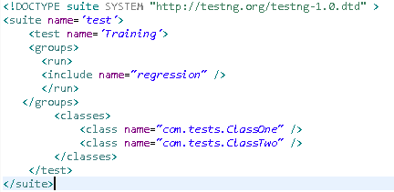
TestNG – Test Methods Attributes
Ignore Test : To ignore any test from being run mark the test “enabled=false” as shown below
@Test(enabled = false)
Groups : Test Methods can be aligned to a group which helps in selective execution
Add Group tag in XML . Groups can be excluded by using the exclude tag
Notes:
ClassTwo of com.attributes

Slide 64


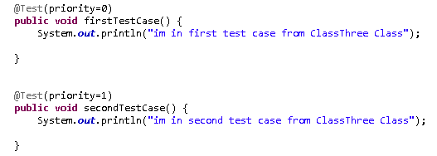
TestNG – Test Methods Attributes
expectedException: Will mark the test case as passed only if it encounters the expected exception class
dependsOnMethods : Execute the method first on which the test method depends on. And if it passes then only the test method will get executed else it would be marked as “skipped”
Priority :Decides the order of test methods within a test class
Notes:
Classone of com.testattributes

Slide 65
Parameterization Test Case
Parameterization using TestNG plays an important role while creating the framework and automation scripts.
It helps in running multiple iteration with different set of data.
Parallel execution is implemented using TestNG. The browsers are passed as the parameters.
There are two ways to parameterize in TestNG:
Using TestNG.xml
Using Dataprovider class

Slide 66
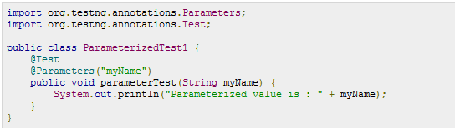
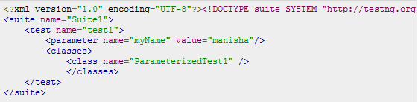
Passing Parameters through TestNG.XML
Create a java test class say ParameterizedTest1.java.
Add test method parameterTest() to your test class. This method takes a String as input parameter.
Add the annotation @Parameters("myName") to this method. The parameter would be passed a values from testng.xml which we will see in the next step.
Create a testng.xml to execute Test case(s).

Slide 67
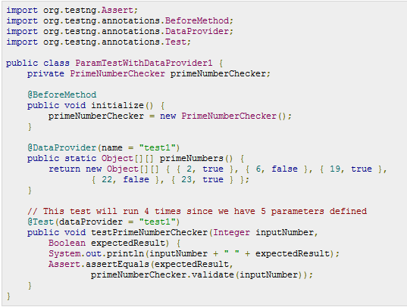
Usage of DataProvider
When you need to pass complex parameters or parameters that need to be created from Java (complex objects, objects read from a property file or a database, etc...), in such cases parameters can be passed using Dataproviders. A Data Provider is a method annotated with @DataProvider. This annotation has only one string attribute: its name. If the name is not supplied, the Data Provider’s name automatically defaults to the method’s name. A Data Provider returns an array of objects.

Slide 68
OVERVIEW OF SELENIUM DRIVERS

Slide 69
DRIVERS AND BROWSERS
WebDriver supports following browsers
HtmlUnit Driver
Firefox Driver
Internet Explorer Driver
Chrome Driver
Safari Browser
Android and iPhone browser (Through Appium and Selendroid)
Windows Phone
Blackberry Phones

Slide 70
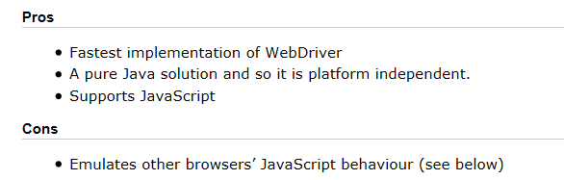
HTMLUNIT DRIVER
Fastest and Most lightweight
Java based implementation of a web browser without GUI

Slide 71
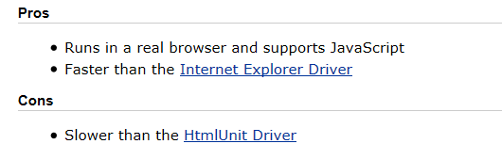
FIREFOX DRIVER
Controls browsers using a firefox plugin.

Slide 72
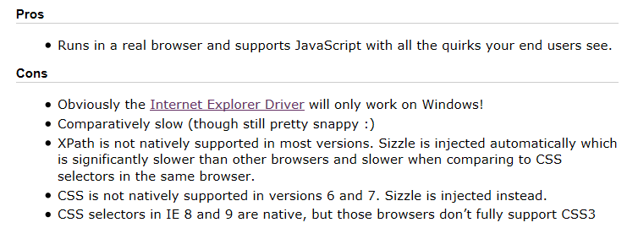
INTERNET EXPLORER DRIVER
Controlled by a .dll

Slide 73
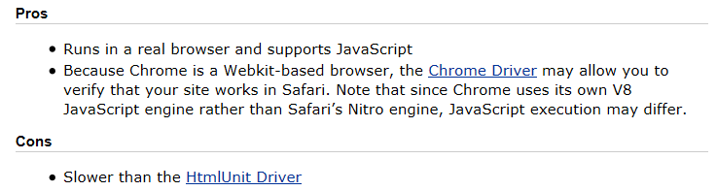
CHROME DRIVER
Maintained through Chromium
Need to include chrome server in PATH

Slide 74
SYNCHRONIZATION
Thread.sleep ??
Machine Specification
Server Specification
Javascript Engine Performance
Networks

Slide 75
SYNCHRONIZATION - Timeouts
Page Load Timeout
This defines the amount of time that Selenium will wait for a page to load. By default, it is set to 0 (which equates to an infinite timeout). If you want to ensure that an error is thrown if your page takes longer than expected to load, you can modify this by using the following code:
driver.manage().timeouts().pageLoadTimeout(15, TimeUnit.SECONDS);
Implicit Wait
An implicit wait is to poll the DOM for a certain amount of time when trying to find an element or elements if they are not immediately available. The default setting is 0. Once set, the implicit wait is set for the life of the WebDriver object instance.
Issues with Implicit Wait :
1) Can slow down test
2) Can break explicit wait
Notes:
Wait for the onload event to be triggered
Check whether new elements are still being added to the DOM

Slide 76

SYNCHRONIZATION
Explicit Wait
Tell the script to wait for a certain condition to occur before proceeding next.
Different Expected conditions on the basis of which the explicit wait can be implemented:
Presence of Element
Element is clickable
Title Contains
Element Selectable
Element Visible
Text to be Present

Slide 77


TAKING SNAPSHOTS
Webdriver has a in built interface to support the screenshot
TakesScreenshot
File screenshot = ((TakesScreenshot)driver).getScreenshotAs(OutputType.FILE);
FileUtils.copyFile(screenshot, new File("c:\\screenshot.jpg"));
Screenshots should be used while creating reports. It helps in analyzing the failures.
Remote Webdriver doesn’t support the TakesScreenshot. So it can be done using below code

Slide 78
ADVANCED INTERACTION
The Actions class(es) allows to build a Chain of Actions and perform them
Click and Hold
Context Click (Right Click)
Drag and Drop
Mouse Hover
Keyboard Actions
Moving to element
Note : The Advanced User Interactions require native events to be enabled. Table can be referred at
http://docs.seleniumhq.org/docs/04_webdriver_advanced.jsp#id3

Slide 79
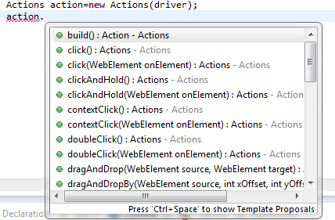
ACTION CLASSES
It is more comprehensive API for describing actions a user can perform on a web page.
This includes actions such as drag and drop or clicking multiple elements while holding down the Control key.
In the below image it shows how to create action class. Also it list down the various methods available for action classes.

Slide 80
ACTION CLASSES
Drag and Drop
Through this an element can be dragged and dropped on some other element.
driver.get("http://jqueryui.com/demos/droppable/");
WebElement draggable = driver.findElement(By.id("draggable"));
WebElement droppable = driver.findElement(By.id("droppable"));
new Actions(driver).dragAndDrop(draggable, droppable).build().perform();
Click and Hold
It allows the user to select multiple items by working as Cntrl+Click
driver.get("http://jqueryui.com/demos/selectable/");
List<WebElement> listItems = driver.findElements(By .cssSelector("ol#selectable *"));
Actions builder = new Actions(driver);
builder.clickAndHold(listItems.get(1)).clickAndHold(listItems.get(2)) .click();
builder.build().perform();

Slide 81
ACTION CLASSES
Context Click
Through context click, user can right click on any element
WebElement webElement = driver.findElement(By.id(location));
actions.contextClick(webElement);
Mouse Hover
There are few in built methods used for mouse hovering
Actions builder = new Actions(driver);
builder.moveToElement(droppable);

Slide 82
JAVASCRIPT EXECUTOR
Javascript can be executed within the browser with the help of JavaScript Executor.
JavascriptExecutor js = (JavascriptExecutor) driver;
js.executeScript("document.getElementById('result').setAttribute('ID', 'newID')");
Can be used to set any attribute of an element
Helps in working with HTML5 elements like video
Can be used to capture the AJAX requests

Slide 83
PROFILING IN WEB DRIVER
With the help of profiling, the settings of browsers can be changed during the execution session. As web driver can access the native API of the browser, so it allows the user to change the default setting as per the requirement.
Few of the setting which can be changed by creating a profile are listed below
Change the default download folder
Load the Add – Ins with the browser
The user agent can be changed
Handling the SSL Certificates
Enabling the native events

Slide 84
FIREFOX PROFILE
User Agent
Accepting SSL Certificates
With the help of following profile, the browser will accept the SSL certificates without any prompt.
FirefoxProfile profile = new FirefoxProfile();
profile.setPreference("general.useragent.override", "iphone");
WebDriver driver = new FirefoxDriver(profile);
driver.get("http://www.timesofindia.com");
ProfilesIni allProfiles = new ProfilesIni();
FirefoxProfile myProfile = allProfiles.getProfile("CertificateIssue");
myProfile.setAcceptUntrustedCertificates(true);
myProfile.setAssumeUntrustedCertificateIssuer(false);
WebDriver Driver = new FirefoxDriver(myProfile);
Driver.get("www.test.com");

Slide 85
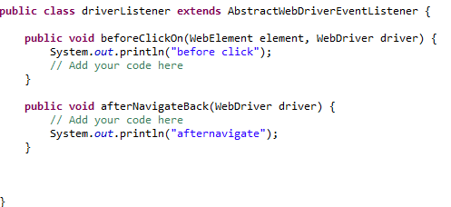

WEBDRIVER LISTENERS
Acts like a recovery scenario
Hooks to the driver
Different Events :
Before Click
After Click
Before navigate
After Navigate
On Exception
Register the listener using following code :

Slide 86
Quiz
What is the difference between implicit wait and explicit wait?
What is the disadvatage of using thread.sleep()?
Which method of Action class can used to drag and drop an element?

Slide 87
Assessments
Write a script to find total no. of images on a flipkart home page.
Write a script to select a value from a custom dropdown on google advance search page
Write a script to select male check box on facebook signup page
Write a script to verify error messages on Gmail login page
On naukri.com pops window will open. You need to switch to a pop-up window and ensure on which pop-up window your are on.
Action Classes
Perform drag and drop : http://jqueryui.com/droppable/
Click and hold : http://jqueryui.com/selectable/
Also find an example for right click*/

Slide 88
AGENDA
Overview of other Selenium features

Slide 89
OVERVIEW OF OTHER SELENIUM FEATURES

Slide 90
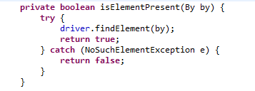
CHECKPOINTS
Selenium doesn’t provide any in built checkpoints for validations so user need to create their own custom checkpoint.
Different validations which can be performed are:
Validate existence of element.
Checking the text of an element.
Image verification.
Database validation.
Custom checkpoints can be created by writing the boolean methods as shown below:
Use below statement for the checkpoint

Slide 91
HOW TO USE DRIVER ACROSS DIFFERENT CLASSES
There can be multiple java files where the test scripts will reside. So it’s important that all the test scripts uses the same driver instance through out the execution.
There are different pattern that ensures that only one instance is created and used across different classes.
As a good practice the automation developer should create a webdriver setup file which will initiate the webdriver session and also can have some generic methods like click, type, navigate etc.
In the next few slides we will discuss how to initiate the web driver session and to be shared across test scripts.

Slide 92
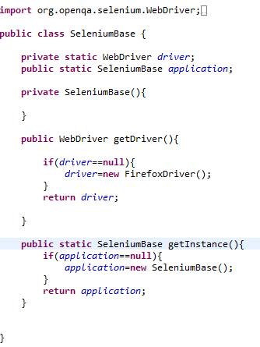
SINGLETON PATTERN
The Singleton's purpose is to control object creation, limiting the number of objects to one only. Since there is only one Singleton instance, any instance fields of a Singleton will occur only once per class, just like static fields. Singletons often control access to resources such as database connections or sockets.
To use driver instance use below code in test scripts :
static WebDriver driver=Seleniumbase.getInstance().getdriver();
Static driver session
First check if session already exist. If not create a new one else return the existing

Slide 93
USING INHERITANCE
Concept of inheritance comes quite handy to create a selenium base file and then all the test scripts extend the base class. All the initiation tasks like web driver creation, database connection or logs are created under the base selenium web driver and the concept of inheritance extends all those instances to the child classes (Test scripts).
One of the major limitation of Singleton pattern is that, it doesn’t allow the parallel execution. So singleton should be avoided when user need to implement parallel execution.
With the help of TestNG ,it becomes quite easy to implement this concept.
Note : This will be discussed in detail after TestNG session

Slide 94

FILE HANDLING USING JAVA
Java IO package has provided many classes which can be used for reading and writing to external test files
FileReader: Used for reading a file

Slide 95

FILE HANDLING USING JAVA
FileWriter: Used to write to a text file

Slide 96


PROPERTIES FILE
Used to store project configuration data or settings like application URL , database server etc. Also can be used to create Object Repository.
It works on the key value pair as shown below
Code to read property file

Slide 97
CREATING OBJECT REPOSITORY
Using Property File
Create a key value pair in Property file
Create a method which will read the values from property file
Example:
login.username=//input[@id='username]
login.password=//input[@id='password']
Constants in Java
Create different java files to create constants
public static By imgNew = By.xpath("//h1/img[@alt='Equinox']");

Slide 98


DESIRED CAPABILITY
Capabilities are options that you can use to customize and configure the session created with the browser. It helps to create a desired session with the browser.
With the help of desired capabilities we can identify which browser to be used for execution in Selenium Grid.
Example of launching Firefox with the help of desired capability:
Launching a chrome profile using desired capabilities:

Slide 99
REMOTE WEB DRIVER
The RemoteWebDriver is composed of two pieces: a client and a server. The client is your WebDriver test and the server will always run on the machine with the browser you want to test. There are two ways to user the server: command line or configured in code.
As the name suggests, it is used to execute the test scripts on any remote machine. Also it supports the implementation of Selenium Grid. Server should be started on the remote machine.
WebDriver driver = new RemoteWebDriver(new URL("http://10.207.60.83: 4444/wd/hub"), DesiredCapabilities.firefox())
Location of the machine where execution will take place
Specified which browser to be used

Slide 100
Assessments
1) Create custom checkpoint for the following type of validations
Element Present
Image Checkpoint
Text Checkpoint
2) Create a utility that will take the snapshot only of the webelement provided as parameter.
3) Create a text file and write your first name, last name and sapient ID in it.
4) Create a property file with three fields url , username and password. Use the values to perform login in the below url http://newtours.demoaut.com/ username = “mercury” password=”mercury”

Slide 101
TestNG Listeners

Slide 102
TestNG Listeners
A TestNG listener always extends the marker interface org.testng.ITestNGListener. Using listeners, one can extend TestNG in their dealings with notifications, reports and test behavior.
TestNG provides you with many more interfaces that extend org.testng.ITestNGListener. Each interface defines one aspect of TestNG.
In order to extend TestNG behavior one needs to implement the TestNG-provided listener interface and then integrate it with TestNG.
Following are the different types of Listeners that are provided in TestNG:
ISuiteListener
ITestListener
IReporter

Slide 103

ISuiteListener
We have a listener for the suite called ISuiteListener.
It has two methods,
onStart
onFinish
Method onStart is invoked before TestNG starts running the suite and onFinish is invoked after TestNG has run the suite.
The listener is called for each suite, if the parent suite contains child suites then the child suites are first run before running the parent suite. This is done so that the results for parent suite can reflect the combined results of the child suites.
In the below configuration we have mentioned the listeners and the test class to run:

Slide 104

We will need to create SuiteListener class which will implement the ISuiteListner. Following code implements the ISuiteListener interface:

Slide 105

Test class where we keep our test scripts should look like this:

Slide 106

Following output will be generated when we run the testng.xml with this particular configuration:

Slide 107
Quiz
Give examples of some of annotations supported by testNG
What are the different ways to parameterize in testNG?
How can you disable a test in TestNG?
What is difference between dependsOnGroups and dependsOnMethods?
What does it mean to pass parameters using dataproviders?

Slide 108
ITestListeners
ITestListener is the listener for test running. You can either implement ITestListener or extend the TestNG provided implementation TestListenerAdapter as it has many convenient methods and we don’ have to re-invent the wheel.
ITestListener has methods on following events:
onStart is invoked after the test class is instantiated and before any configuration method is called
OnTestStart is invoked before every test along with the message passed as parameter.
onTestSuccess is invoked on success of a test
onTestFailure is invoked on failure of a test
onTestSkipped is invoked whenever a test is skipped
onTestFailedButWithinSuccessPercentage is invoked each time a method fails but is within the success percentage requested.
onFinish is invoked after all the tests have run and all their Configuration methods have been called.
We will implement ITestListener in a class and then use it as a listener.
Also we will make a class to use listeners and then integrate them in a testng.xml. Refer code mentioned on the next page.

Slide 109

DemoTestListener class to implement the ITestListners will be as follows:

Slide 110

TestNG class using these the above mentioned listeners will be as follows:

Slide 111


And the testng.xml using listeners with the test script will be as follows
Finally, the output of following listener program will be as follows:

Slide 112
onStart is invoked first.
onTestStart is called once for each test before it is invoked.
onTestSuccess is invoked whenever a test passes. In our example, f and f2 always passes whereas, f3 passes the first time.
onTestFailure is called for f4 as f4 will always fail. It is also called for f3 as it fails once out of two times that it is invoked.
onTestSkipped is called once for f5 as it is bound to skip.
onTestFailedButWithinSuccessPercentage is called once for f3, the first time it fails. It is not called again as it doesn’t match the requested successPercentage of 20.
Finally onFinish is called once when the tests are all run.

Slide 113

IReporter
IReporter is the listener you need to implement if you want to generate a report after all the suites are run.
In my test class, we will create three test methods, one pass, one fail and one skip. Refer below code:

Slide 114

Now we will create a class which implements the IReporter interface and override the generateReport method as follows:

Slide 115


Finally, We will create the testng.xml as follows:
When we run this particular testng.xml as a single suite then the following output will be generated:

Slide 116
ReportNG

Slide 117
ReportNG
ReportNG is a simple plug-in for the TestNG unit-testing framework to generate HTML reports as a replacement for the default TestNG HTML reports. You can also customize html report with the help of TestNG listeners.
ReportNG Is very good add-on to generate Interactive and readable reports for selenium webdriver tests.
ReportNG can be integrated in your project with following steps:
You need to download following jars:
Guice-3.0.jar
Velocity-dep-1.4.jar
Reportng-1.1.4.jar
Add the jars in your project build path.
Right Click on project.
Build path.
Configure buildpath.
Add external jars.
Disable default listeners of TestNG.
Right click on project folder In eclipse.
Go to Properties. - It will open Properties dialog.
Go to TestNG and check Disable default listeners checkbox.

Slide 118

We need to add the below two listeners to testng.xml file.
<listeners> <listener class-name="org.uncommons.reportng.HTMLReporter"/>
<listener class-name="org.uncommons.reportng.JUnitXMLReporter"/> </listeners>
Finally testng.xml file should look as the below for the given example :
<!DOCTYPE suite SYSTEM "http://testng.org/testng-1.0.dtd" >
<suite name="Suite1" verbose="1" >
<listeners> <listener class-name="org.uncommons.reportng.HTMLReporter"/>
<listener class-name="org.uncommons.reportng.JUnitXMLReporter"/> </listeners>
<test name="Regression Test Suite" >
<packages> <package name="packOne" />
<package name="packTwo" />
</packages>
</test>
</suite>

Slide 119



Slide 120
Configuring ReportNG with Maven Project
You need to add following dependency in the pom.xml
<dependency>
<groupId>org.uncommons</groupId>
<artifactId>reportng</artifactId>
<version>1.1.4</version>
<scope>test</scope>
</dependency>
<dependency>
<groupId>com.google.inject</groupId>
<artifactId>guice</artifactId>
<version>3.0</version>
</dependency>
<dependency>
<groupId>org.apache.velocity</groupId>
<artifactId>velocity</artifactId>
<version>1.7</version>
</dependency>
Disable default listeners of TestNG.
Right click on project folder In eclipse.
Go to Properties. - It will open Properties dialog.
Go to TestNG and check Disable default listeners checkbox.

Slide 121

Add following property inside configurations tag in sure-fire plugin, just above the suitexmlFile tag:
<properties> <!-- Setting ReportNG listeners -->
<property> <name>listener</name>
<value>org.uncommons.reportng.HTMLReporter, org.uncommons.reportng.JUnitXMLReporter</value>
</property>
</properties>
Refer below screen shot for the same:

Slide 122
We need to add the below two listeners to testng.xml file.
<listeners> <listener class-name="org.uncommons.reportng.HTMLReporter"/>
<listener class-name="org.uncommons.reportng.JUnitXMLReporter"/> </listeners>
Finally testng.xml file should look as the below for the given example :
<!DOCTYPE suite SYSTEM "http://testng.org/testng-1.0.dtd" >
<suite name="Suite1" verbose="1" >
<listeners> <listener class-name="org.uncommons.reportng.HTMLReporter"/>
<listener class-name="org.uncommons.reportng.JUnitXMLReporter"/> </listeners>
<test name="Regression Test Suite" >
<packages> <package name="packOne" />
<package name="packTwo" />
</packages>
</test>
</suite>
Navigate to Workspace directory of the TestNG testcases.
Execute command -- mvn clean.
Execute command -- mvn install.

Slide 124
Page Object Model

Slide 125

Page Object Model
The Page Object pattern represents the screens of your web app as a series of objects and encapsulates the features represented by a page.
It allows us to model the UI in our tests.
A page object is an object-oriented class that serves as an interface to a page of your AUT.

Slide 126

Benefits

Slide 127

Framework with Page Object Model

Slide 128

Implementation
Split up the page on the basis of functionalities and will have the methods like LoginToGmailAsValidUser and LoginToGmailAsInvalidUser as shown in below example :

Slide 129

PageFactory
This is a Factory class to make using Page Objects simpler and easier.
Instantiate an instance of the given class, and set a lazy proxy for each of the WebElement and List<WebElement> fields that have been declared, assuming that the field name is also the HTML element's "id" or "name".
We follow the concept of separation of Page Object repository and Test methods. Additionally with the help of PageFactory class we use annotations @FindBy to find WebElement. We use initElements method to initialize web elements.
Page Factory is an optimized way to create object repository in POM concept.
You can call the initElements method in your constructor so that as soon as we create an object of our page then we can initialize all the elements of the page.

Slide 130


@FindBy can accept tagName, partialLinkText, name, linkText, id, css, className, xpath as attributes. Refer below code:
In the same manner, if we want to find similar type of elements than we can use the @FindAll annotation and find a list of similar webElements. Refer below code:

Slide 131
UNDERSTANDING SELENIUM GRID

Slide 132

DISTRIBUTED TESTING WITH SELENIUM GRID
Selenium Grid is used to run the tests parallel
It distributes the test across different machines

Slide 133
SELENIUM GRID
Hub
The Hub acts like the central point, which will receive the entire test request and distribute it to the right nodes.
Selenium server act as the hub and to start the server use the following command
“java -jar selenium-server-standalone-2.35.0.jar -role hub”
Navigate to http://localhost:4444/grid/console and you see a hub window
Nodes
These are the machines where the executions take place
Nodes must be registered to the hub
“ java -jar selenium-server-standalone-2.35.0.jar -role node -hub http://localhost:4444/grid/register “

Slide 134

GRID – CONFIGURING NODES
Nodes should be configured for the execution.
Command Prompt
While starting the node, you can specify the node configuration by using following parameters.
“-browser browserName=firefox,version=3.6,maxInstances=5,platform=LINUX”
Different browsers can be used by changing the values of browser name etc.
JSON file
java -jar selenium-server-standalone.jar -role hub -hubConfig hubconfig.json

Slide 135

GRID – RUNNING THE TEST CASES
Desired Capabilities: Defines the browser, platform and other settings for the execution
Remote Webdriver : Send the request to hub which redirect the tests to the nodes as per desired capability.

Slide 136
THANK YOU

